Slide 1
Volunteer
Training

Slide 2
DEVELOPING A SUCCESSFUL PARTNERSHIP
Meet with the teacher/staff member before you start.
Get to know the school grounds.
Establish positive relationships with the students.
If you can’t fulfill your volunteering commitment, please inform your teacher as well as the front office.

Slide 3
Initial Checklist
When you begin volunteering, please discuss the following with the teacher:
Your availability
The teacher’s classroom policies and procedures (including how and when to talk with/interrupt the teacher
Your specific duties and the materials you should use
How to contact the teacher if your schedule changes
Plans for when the teacher is absent
How students will refer to you- Mr./Mrs.
Your specific interests and talents
Teachers will plan a volunteer schedule based on your availability and classroom needs. You will be contacted by the teacher with the classroom volunteer schedule.

Slide 4
Procedures and Policies
ALWAYS sign in and out of the office
ALWAYS wear your VISTOR BADGE made by the front office.
ONLY go to the teacher that is expecting you. It is important for staff to know that you are in the building and are bale to locate you in an emergency.
Please TURN OFF your cell phone while in the school building.
Dress Code- Follow dress code for students.
Student Discipline- It is the teachers responsibility.

Slide 5
Getting Off to a Good Start
When Working With an Individual Student or a Group:
Take some time to get to know the students.
Find out what they do outside of school, what sports they play, favorite T.V. shows, games, pets, etc...
Be a good listener. Let the students know that you care about their thoughts and ideas.
Accept a student for who s/he is…don’t try and make him/her into something s/he is not. You are here to help, not change him/her.
Find out what the teacher wants you to work on…get specifics.
Discuss with the teacher ahead of time the classroom management plan and what is expected if a student is uncooperative.
Indicate to the children how you would like to be addressed.
Be encouraging. Recognize effort as well as products.
Encourage all the students, not just the ones with the correct answer.
Give each student time to answer…don’t allow other students to jump in and answer for him/her.

Slide 6
CONFIDENTIALITY
There may be a time when a student shares something with you that causes you some concern about their personal safety. If this should be the case, please immediately contact the classroom teacher, counselor or principal. That person will know the proper procedure to deal with this situation.
You will be serving in a unique capacity with our students. Sometimes students share things with a volunteer that they have not shared with anyone else. This information may be about private family matters or information about themselves that they are entrusting to you. It is very important to the integrity of your work with students that you do not share this information with others. If you feel it is important that another person have this information, please talk to the teacher, counselor or the principal.
Below are some examples that could arise, outside of school, related to confidentiality:
“Wasn’t it cute when….”
When parents ask questions…
When you see or overhear something…
“What do you think about (teacher)?”

Slide 7
One Final Note
It is important for all volunteers to remember the following:
Be responsible and safe- Children first!
Respect confidentiality. Students and staff have a right to privacy.
Be professional.
Communicate openly with faculty.
Ask for help when needed.

Slide 8
Guidelines for Volunteers
Prince William County School Board Policy (Below are a few details from school board policy):
Volunteers will work within guidelines established by the school administration and will work under the direction and supervision of teachers and school staff members
Volunteers will not have access to student records and grades
Volunteers may not supervise a class during a teacher’s absence
Volunteers may not bring children who are not registered in the school when they tutor, mentor, assist in the classroom media center, office, cafeteria, clinic or health screenings, or when chaperoning field trips
Fire Drills/Tornado Drills/Evacuation Drills
Coles Elementary is required to conduct Fire Drills. If a drill is conducted while you are anywhere in the school, please exit the building immediately. Our students and staff also practice other drills to ensure students know how to respond if these situations were ever to occur during the school day.
Regulation 511.10-1 Guidelines for Volunteering in Prince William County Schools
Regulation 651-2; Confidentiality of Student-Disclosed Information

Slide 9
Directions to be a Volunteer
Participate in Training
Sign regulation
Send regulation to school
You’re ready to volunteer!
In person or virtually via the Coles website
Print and sign regulation
Send signed regulation to school office (Attention to Stephani Ferrufino)
Connect with teacher about how you can support!

Slide 10
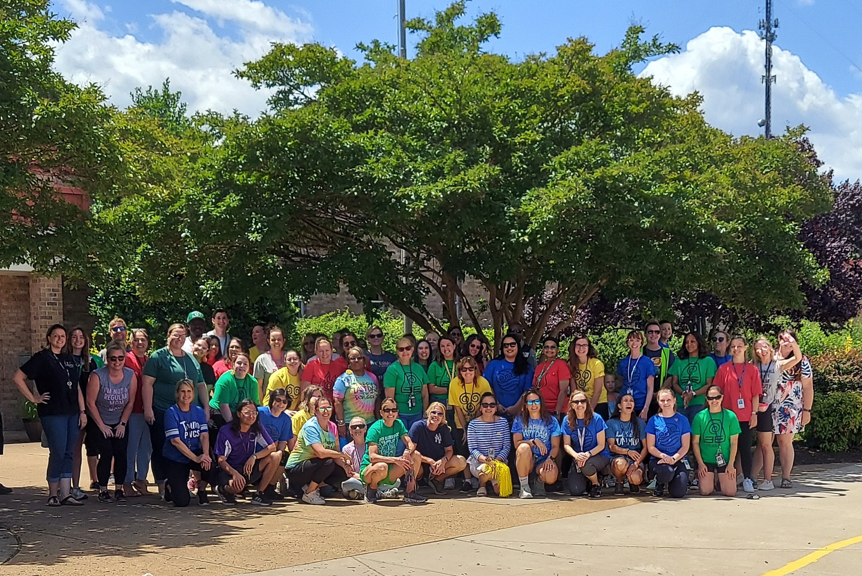
Thank you for your willingness to volunteer at Coles Elementary School!

